Slide 1

#XamExpertDay
Welc me

Slide 2
Tobias Hoppenthaler
@hot33331
Xamarin Cologne User Group
@XamarinCologne

Slide 3
Misc
WIFI
connect to MSFTGUEST
Event Attendee Code is msevent23sj
The official hashtag for the Conference: #XamExpertDay

Slide 4
Agenda
09:10 - 09:40 LAURENT BUGNION
Keynote : Azure Functions and Xamarin
9:40 - 10:20 GERALD VERSLUIS
Skynet activated – Building smarter apps with Cognitive Services and Xamarin
10:30 - 11:20 KERRY W. LOTHROP
Is your app secure?
11:40 - 12:20 GLENN VERSWEYVELD
Learn by doing! – Xamarin Workbooks
12:20 - 13:30
Lunch
13:30 - 14:20 THOMAS BURKHART
Get Hungry for ReactiveUI with Xamarin Forms
14:30 - 15:20 PIETER NIJS
Realm, the cool new kid in Xamarin town
15:30 - 16:20 GEERT VAN DER CRUIJSEN
Building Cloud native mobile apps with Azure & Xamarin
16:30 - 17:20 TOMASZ CIELECKI
Learn how to create custom views on Android using best practices, avoiding GPU overdraw, slow animations and more
17:25 - ...
Closing keynote, socializing and drinks 🍻

Slide 5
Speakers Corner
During Keynote
Tomasz Cielecki is available for mvvmcross, Android, iOS and uwp native
During Workbooks
Geert van der Cruijsen is available for mobile + cloud and mobile Devops
During Realm and Custom Android Views
Bart Lannoeye is available for PRISM
All sessions except keynote
Laurent Bugnion is available for Azure and MVVM Light
Jan Van de Poel available for Mvvmcross, xamarin ios, app distribution

Slide 6
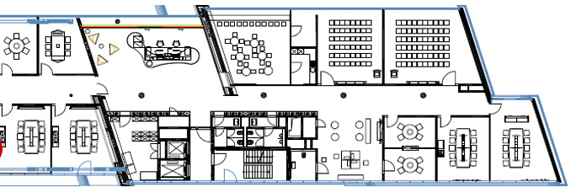
Floorplan
Main Conference
Speakers Corner

Slide 7





Sponsors

Slide 8
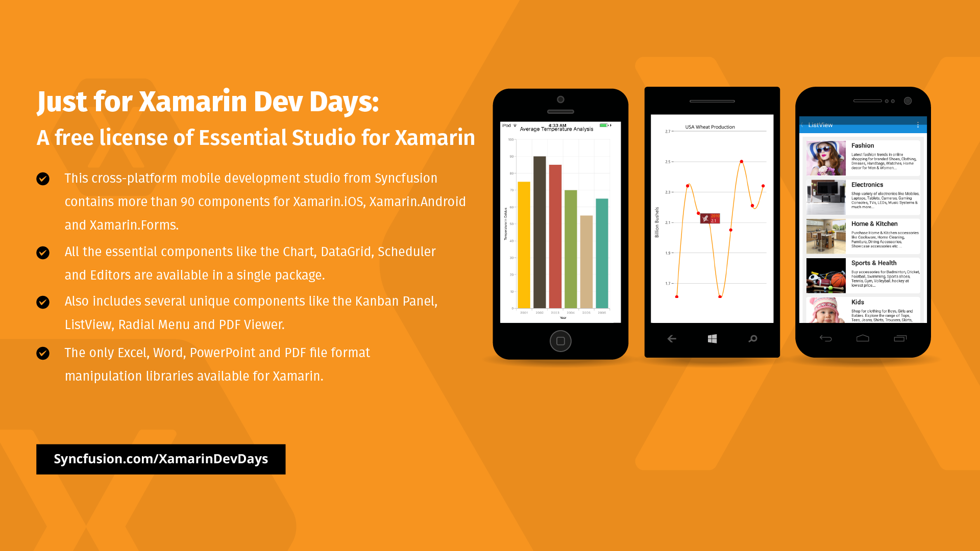
Sponsors

